Slide 1
Rigid Body Motion
A Comprehensive Introduction

Slide 2
Motivation

Slide 3
Motiviation
Rigid Body Motion is all around us
Rigid Body Motion is the game physics concept in use
Bullet, Havok, ODE all use this concept
You need to know about it if you want to work with and understand physics engines!

Slide 4
Overview
Short Math Primer
Vector
Dot Product
Cross Product
Calculus
Kinematics
Linear Motion
Angular Motion in 2D
Statics
Force
Newton’s Laws of Motion
Rigid Bodies
Field Forces
Contact Forces
Moment
Net Force and Net Torque
Center of Mass
Kinetics
Linear Momentum
Angular Momentum
Integration
Inertia Tensor in 2D
Inertia Tensor in 3D
Bibliography

Slide 5
Rigid Body
A rigid body (Starrkörper) is a solid body that is not deformable.
Rigid Body
Soft Body

Slide 6
Game Engine Example
Rigid Body Update Code
for each (RigidBody* body in scene->rigidBodies) {
auto contacts = scene->determineContacts(body);
auto fieldForces = scene->determineFieldForces(body);
auto totalForce = computeTotalForce(contacts, fieldForces);
auto totalMoment = computeTotalMoment(contacts);
body->linearMomentum.integrate(timeStep, totalForce);
body->angularMomentum.integrate(timeStep, totalMoment);
body->velocity = body->linearMomentum / body->mass;
body->angularVelocity = body->invInertiaTensor *
body->angularMomentum;
body->position.integrate(timeStep, body->velocity);
body->rotation.integrate(timeStep, body->angularVelocity);
}

Slide 7
Where We Are
Rigid Body Update Code
for each (RigidBody* body in scene->rigidBodies) {
auto contacts = scene->determineContacts(body);
auto fieldForces = scene->determineFieldForces(body);
auto totalForce = computeTotalForce(contacts, fieldForces);
auto totalMoment = computeTotalMoment(contacts);
body->linearMomentum.integrate(timeStep, totalForce);
body->angularMomentum.integrate(timeStep, totalMoment);
body->velocity = body->linearMomentum / body->mass;
body->angularVelocity = body->invInertiaTensor *
body->angularMomentum;
body->position.integrate(timeStep, body->velocity);
body->rotation.integrate(timeStep, body->angularVelocity);
}

Slide 8
Short Math Primer

Slide 9
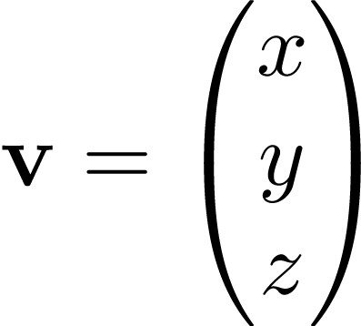
Vector
A vector is a matrix with a single column:
or denotes the magnitude of the vector.
This is just a stub to show the notation : - )
You all know everything about vertices and matrices from your Linear Algebra lecture.

Slide 10
Dot Product
The dot product (Skalarproduct) of two vectors is the scalar , where is the angle between the two vectors.
Notes:
Needed or unused?

Slide 11
Cross Product
The cross product (Kreuzprodukt) of two vectors is a vector that is perpendicular to both and . The length of the resulting vector is , where is the angle between and .
You can use the right-hand rule (Rechte-Hand-Regel) to visualize the cross product.

Slide 12
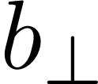
Cross Product

Slide 13
Branches of Mechanics
There are three branches of mechanics that are of interest to us:
Definition
Kinematics (Kinematik) describes the motion of objects without regard for the reason of their movement.
(from Wikipedia)
Definition
Dynamics (Dynamik) or also called Kinetics (Kinetik) examines the correlation between an object‘s motion and the reasons for it.
(from Wikipedia)
Definition
Statics (Statik) analyzes the motion of objects without regard for the reason of their movement.
(from Wikipedia)

Slide 14
Kinematics

Slide 15
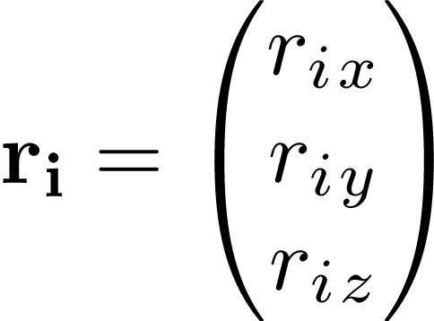
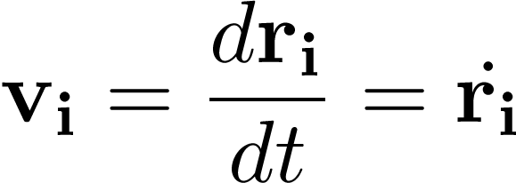
Linear Motion
Let’s look at the movement of a simple particle (Massenpunkt) . We identify a particle by its position .
The velocity of a particle is its change of position over time:
The speed (Tempo) of a particle is simply the magnitude of its velocity: .
Likewise the acceleration is the change of velocity over time:

Slide 16
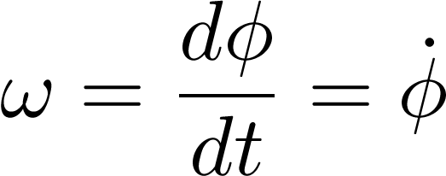
Angular Motion in 2D
Imagine that a particle moves on a circle around the origin.
We can exactly describe the particle’s position by the angle between the particle and the x-axis at any moment of time.
Like with linear motion, we can examine the change of over time and get the angular velocity :
Similarly the angular acceleration is the change of over time:

Slide 17
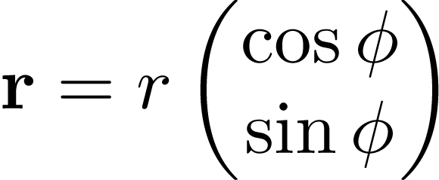
Example: Circular Movement
And because
Notes:
Speed and acceleration speed!

Slide 18
Example: Circular Movement in 3D
If we look at the same rotation in 3D nothing changes. We give a direction as rotation axis and set:
Since it follows that:
with

Slide 19
Example: Rotation around an Axis in 3D
In the general case we have , so does our equation fail?
with

Slide 20
Angular Motion in 3D
In 3D we can’t use a single angle to describe the orientation. Instead we use a rotation matrix .
The derivative of a matrix is again a matrix, so instead we need something simpler: The change of the rotation matrix from one moment to the next is nothing else but a rotation itself. We can describe any rotation using the rotation axis with its magnitude being the amount of rotation.

Slide 21
Angular Motion in 3D
It can be shown that (with a column-wise cross product).
Now we know how to get from to and can use the formulas that we have deduced when rotating a point around an axis:
to convert from angular velocity to linear velocity.

Slide 22
Summary
Linear Motion:
Position
Velocity
Acceleration
Angular Motion:
Orientation or
Angular Velocity
Angular Acceleration

Slide 23
Statics

Slide 24
Force
A force (Kraft) is any influence that causes a free body to undergo an acceleration.
A force has both magnitude and direction, making it a vector quantity.
(from Wikipedia)
It also has a point of action (Angriffspunkt): the point where the force is applied; and a line of action (Wirkungslinie): the line along the force’s direction through the point of action.

Slide 25
Force
line of action
body
force
point of action

Slide 26
Newton’s Laws of Motion
Second Law
The acceleration of a body is proportional to the net force acting on the body and this acceleration is in the same direction as the net force.
Third Law
For every force acting on a body, there is an equal and opposite reacting force.

Slide 27
Rigid Bodies
A rigid body (Starrkörper) is a solid body that is not deformable.
If we take a body to be made-up of particles, then the definition means that the distance between any two particles always remains constant.
This, of course, is an idealization, because every body can be deformed if enough stress is applied.

Slide 28
Rigid Bodies
Because of this rigidness for a rigid body only its position and orientation in space need to be stored.
They suffice to describe its instantaneous state.
Another special property of rigid bodies is that the point of action for a force is irrelevant – only the line of action matters.
Rigid Body
Soft Body

Slide 29
Rigid Bodies – Particle Model
We already know particles. They have mass but no orientation. A group of particles, however, has orientation.
We can use a set of particles to model a rigid body. Each particle has its own properties: mass, position, velocity, etc. But they are all linked together by their constant distance to each other. We will use this to deduce many important properties of rigid bodies.
We will see later that many properties of the whole rigid body are made up of the sum of its particles.
The mass of the rigid body for example is:

Slide 30
Where We Are
Rigid Body Update Code
for each (RigidBody* body in scene->rigidBodies) {
auto contacts = scene->determineContacts(body);
auto fieldForces = scene->determineFieldForces(body);
auto totalForce = computeTotalForce(contacts, fieldForces);
auto totalMoment = computeTotalMoment(contacts);
body->linearMomentum.integrate(timeStep, totalForce);
body->angularMomentum.integrate(timeStep, totalMoment);
body->velocity = body->linearMomentum / body->mass;
body->angularVelocity = body->invInertiaTensor *
body->angularMomentum;
body->position.integrate(timeStep, body->velocity);
body->rotation.integrate(timeStep, body->angularVelocity);
}

Slide 31
Field Forces
A field force (Feldkraft) is a force that is not transferred through direct contact but through a force field (Kraftfeld).
Example: Gravity

Slide 32
Contact Forces
A contact force (Kontaktkraft) is a force that is transmitted through a contact point of two bodies that touch.
Because of both bodies apply the same force (but in opposite directions) on each other.
It consists of a normal force (Normalkraft) perpendicular to the contact plane and a friction force (Reibungskraft) that lies on the contact plane.

Slide 33
Where We Are
Rigid Body Update Code
for each (RigidBody* body in scene->rigidBodies) {
auto contacts = scene->determineContacts(body);
auto fieldForces = scene->determineFieldForces(body);
auto totalForce = computeTotalForce(contacts, fieldForces);
auto totalMoment = computeTotalMoment(contacts);
body->linearMomentum.integrate(timeStep, totalForce);
body->angularMomentum.integrate(timeStep, totalMoment);
body->velocity = body->linearMomentum / body->mass;
body->angularVelocity = body->invInertiaTensor *
body->angularMomentum;
body->position.integrate(timeStep, body->velocity);
body->rotation.integrate(timeStep, body->angularVelocity);
}

Slide 34
Moment (Motivation)

Slide 35
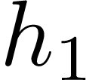
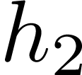
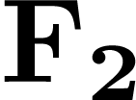
Law of the Lever
Law of the Lever (Hebelgesetz)
A level is in equilibirum if the forces applied on each end is inversely proportional to the distance of the points of action to the pivot:

Slide 36
Moment
Moment (Drehmoment) is a measure for the ability of a force to rotate an object. It is always defined with respect to a point of reference :

Slide 37
Moment

Slide 38
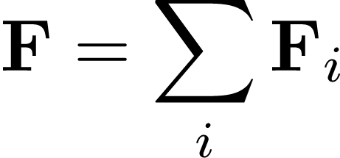
Net Force and Net Torque
If we have forces (with points of action etc), then we can calculate the net force and net moment in respect to a point of reference with:
That is, we can simply add up the forces and moments to get the net force and net moment.

Slide 39
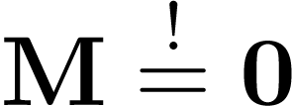
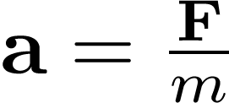
Center of Mass (Motivation)
What is a good choice for our point of reference?
It would be nice to choose it in such a way that applying a force to it won’t induce any actual moment on an unconstrained rigid body, that is .
This means that every particle as well as the whole rigid body will experience the same acceleration. So if a force is applied to the point of reference, the whole rigid body should be accelerated by . is the mass of the whole rigid body, ie . Then:

Slide 40
Center of Mass (Deduction)
Because the last statement has to hold for any force , it follows that , that is:

Slide 41
Center of Mass
The center of mass ((Masse-)Schwerpunkt) of a rigid body is the mass-weighted average of all particle positions:
The center of mass of a rigid body moves as if the whole mass of the rigid body were focused in it and all external forces acted on it.

Slide 42
Where We Are
Rigid Body Update Code
for each (RigidBody* body in scene->rigidBodies) {
auto contacts = scene->determineContacts(body);
auto fieldForces = scene->determineFieldForces(body);
auto totalForce = computeTotalForce(contacts, fieldForces);
auto totalMoment = computeTotalMoment(contacts);
body->linearMomentum.integrate(timeStep, totalForce);
body->angularMomentum.integrate(timeStep, totalMoment);
body->velocity = body->linearMomentum / body->mass;
body->angularVelocity = body->invInertiaTensor *
body->angularMomentum;
body->position.integrate(timeStep, body->velocity);
body->rotation.integrate(timeStep, body->angularVelocity);
}

Slide 43
Kinetics

Slide 44
Linear Momentum
The linear momentum (Impuls) of a particle is defined as:
The linear momentum of a rigid body is the sum of the linear momentums of all its particles:
The linear momentum of a system of bodies is a conserved quantity (Erhaltungsgröße), ie the total amount never changes inside the system.
This is called conservation of momentum (Impulserhaltung).

Slide 45
Linear Momentum and Force
Look at the derivative of :
But is constant and thus . We get:
Derivative of Linear Momentum = Force
The linear momentum changes according to the applied force:

Slide 46
Newton’s First Law of Motion
Newton’s First Law
Every object in a state of uniform motion tends to remain in that state of motion unless an external force is applied to it. This is the concept of inertia (Trägheit).
Proof:
This follows directly from the conservation of momentum:
If then , and then and since the mass is constant, we see that the velocity is constant, too.

Slide 47
Angular Momentum
The angular momentum (Drehimpuls) of a particle is defined as:
with respect to a point of reference .
The angular momentum of a rigid body is the sum of the angular momentum of its particles:
Angular momentum is a conserved quantity, too, that is it stays constant for a system of particles (except if outer forces are applied).

Slide 48
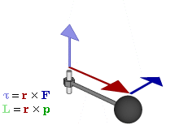
Angular Momentum and Moment
Derivative of Angular Momentum = Moment
Angular momentum changes according to the applied momentum (around the center of mass):
Proof Sketch:

Slide 49
Integration
The problem is that you know the net moment and net torque, but want to know the linear and angular momentum.
From the differential equation we need to evaluate:
The integration steps in a rigid body simulation can be as difficult and complicated as you want.
To solve this you can eg use a simple Euler step:

Slide 50
Summary
Linear Momentum
Angular Momentum
Conservation of Linear Momentum
Conservation of Angular Momentum
Linear Momentum = Integrated Force:
Angular Momentum = Integrated Moment:
Integration = actual problem

Slide 51
Where We Are
Rigid Body Update Code
for each (RigidBody* body in scene->rigidBodies) {
auto contacts = scene->determineContacts(body);
auto fieldForces = scene->determineFieldForces(body);
auto totalForce = computeTotalForce(contacts, fieldForces);
auto totalMoment = computeTotalMoment(contacts);
body->linearMomentum.integrate(timeStep, totalForce);
body->angularMomentum.integrate(timeStep, totalMoment);
body->velocity = body->linearMomentum / body->mass;
body->angularVelocity = body->invInertiaTensor *
body->angularMomentum;
body->position.integrate(timeStep, body->velocity);
body->rotation.integrate(timeStep, body->angularVelocity);
}

Slide 52
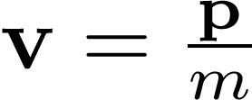
Linear Momentum and Linear Velocity
From the definition of linear momentum we can directly identify .

Slide 53
Angular Momentum and Angular Velocity
We know:
.
depends on the angular velocity indirectly.
Using this fact, it is possible to transform the equation to
,
where is the inertia tensor (Trägheitstensor).

Slide 54
Inertia Tensor in 2D
In 2D the moment definition can be simplified to scalars (like we did for the moment):
with
If we look at an angular motion, it can also be thought of as circular motion around the center of gravity and since is collinear with , we know that it is perpendicular to , this gives . From the slide about circular movement we also know that
.

Slide 55
Inertia Tensor in 2D
with

Slide 56
Inertia Tensor in 2D
In 2D the inertia tensor is just a scalar. It is the squared distance of all particles to the center of gravity weighted by their mass:

Slide 57
Inertia Tensor in 3D
Definition
In 3D the inertia tensor is a matrix:
The deduction is similar to the 2D case, only more heavy-handed.

Slide 58
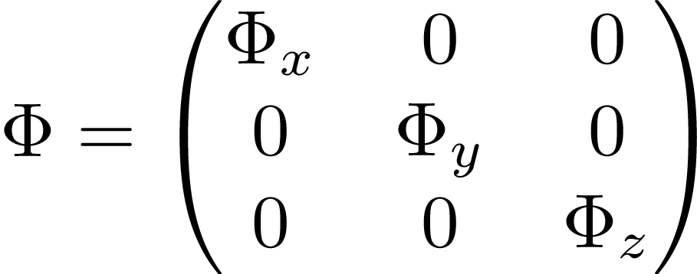
Intuition behind the Inertia Tensor
It is possible to rotate many objects in such a way that is diagonal.
The bigger the diagonal entry the more inert the object is regarding a rotation around that axis.
The smaller is in total, the faster the object’s rotation axis can change.

Slide 59
Where We Are
Rigid Body Update Code
for each (RigidBody* body in scene->rigidBodies) {
auto contacts = scene->determineContacts(body);
auto fieldForces = scene->determineFieldForces(body);
auto totalForce = computeTotalForce(contacts, fieldForces);
auto totalMoment = computeTotalMoment(contacts);
body->linearMomentum.integrate(timeStep, totalForce);
body->angularMomentum.integrate(timeStep, totalMoment);
body->velocity = body->linearMomentum / body->mass;
body->angularVelocity = body->invInertiaTensor *
body->angularMomentum;
body->position.integrate(timeStep, body->velocity);
body->rotation.integrate(timeStep, body->angularVelocity);
}

Slide 60
Where We Are
Rigid Body Update Code
for each (RigidBody* body in scene->rigidBodies) {
auto contacts = scene->determineContacts(body);
auto fieldForces = scene->determineFieldForces(body);
auto totalForce = computeTotalForce(contacts, fieldForces);
auto totalMoment = computeTotalMoment(contacts);
body->linearMomentum.integrate(timeStep, totalForce);
body->angularMomentum.integrate(timeStep, totalMoment);
body->velocity = body->linearMomentum / body->mass;
body->angularVelocity = body->invInertiaTensor *
body->angularMomentum;
body->position.integrate(timeStep, body->velocity);
body->rotation.integrate(timeStep, body->angularVelocity);
}

Slide 61
Questions?

Slide 62
Bibliography
“Technische Mechanik 1 & 3” by Gross, Hauger, Schröder & Wall
“Physically Based Modeling” by Pixar (SIGGRAPH 2001)
“Mathematics for 3D Game Programming & Computer Graphics” by Eric Lengyel
“Physics for Game Developers” by David M. Bourg
“Game Physics” by David H. Eberly

